Slide 1
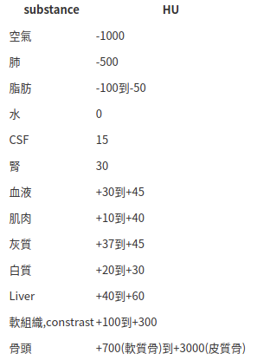
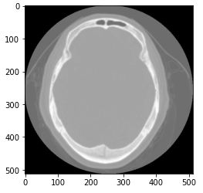

Slide 2
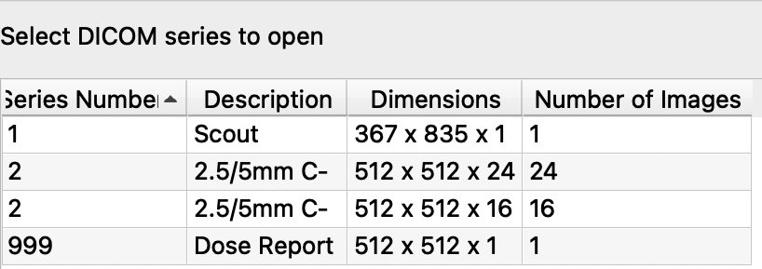
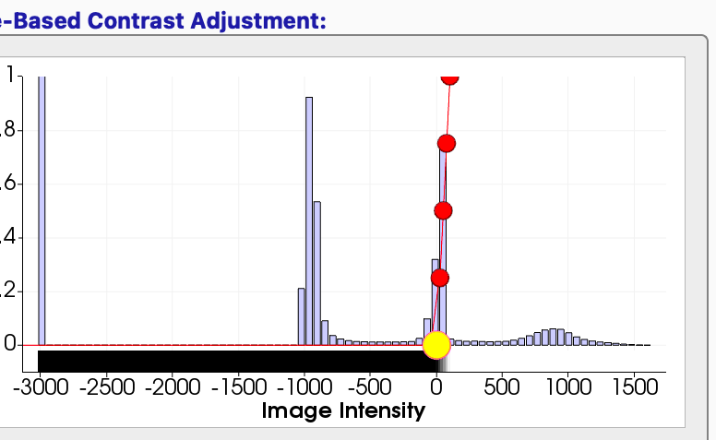
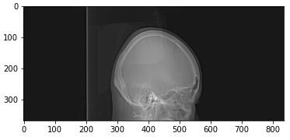
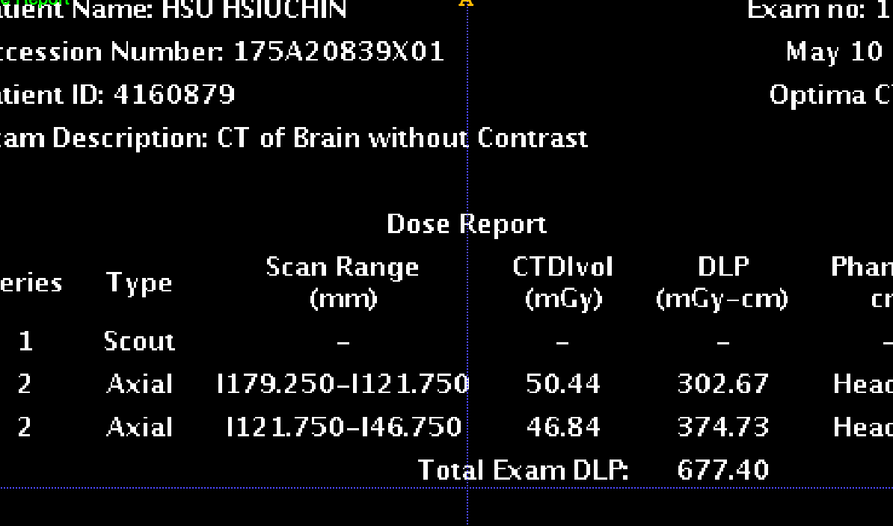

Slide 3
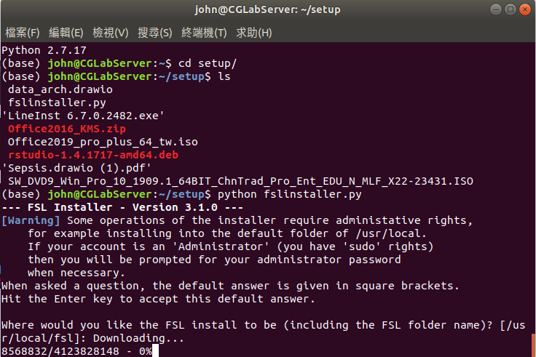

Slide 4
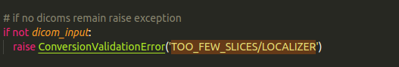
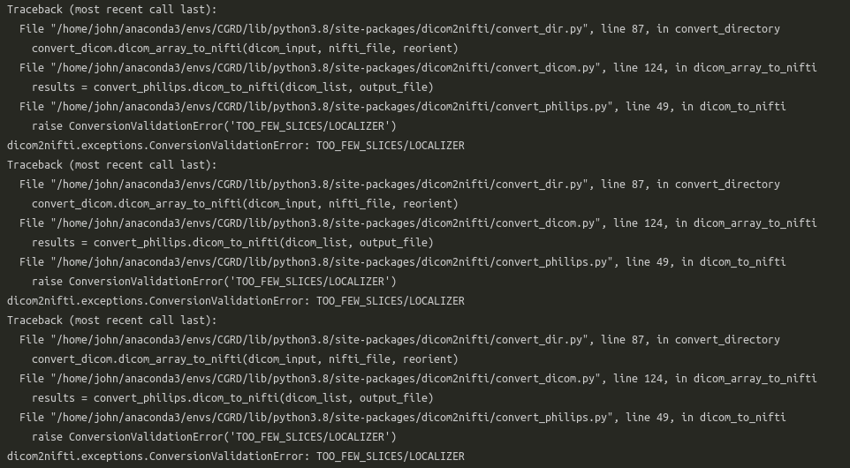
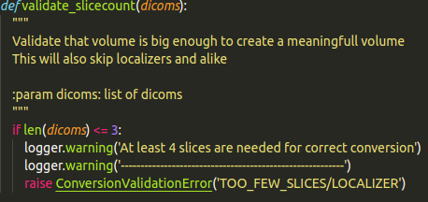

Slide 5
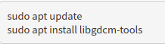
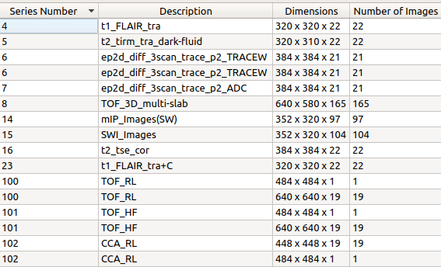
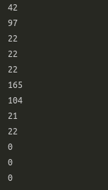
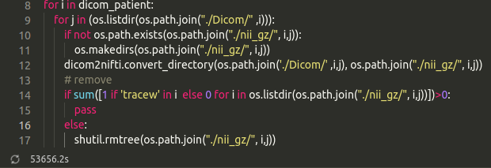

Slide 6
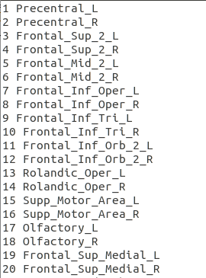
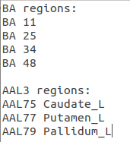
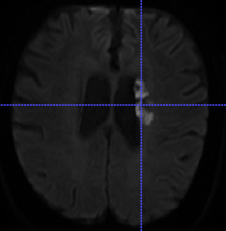

Slide 7
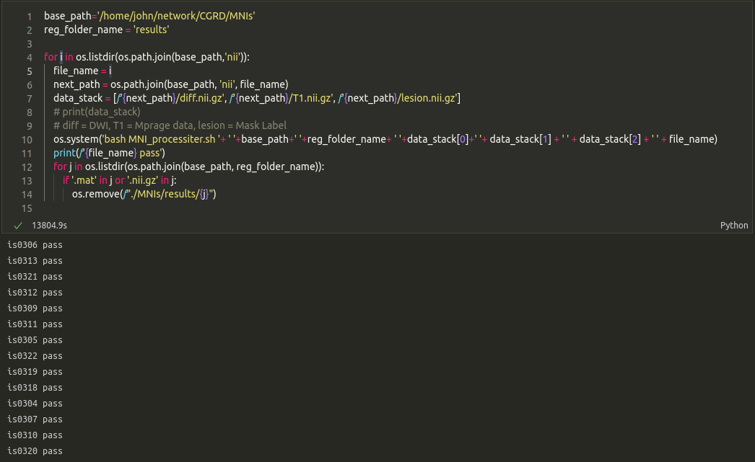
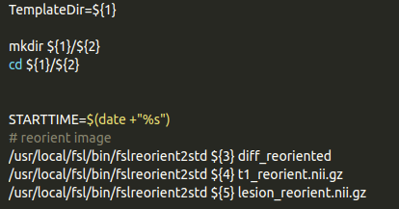
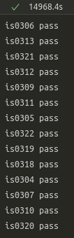

Slide 8
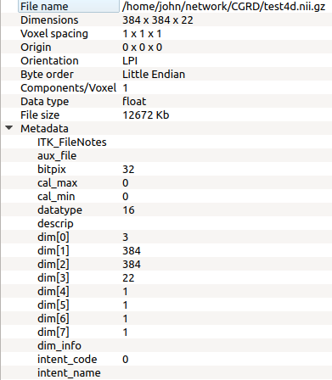
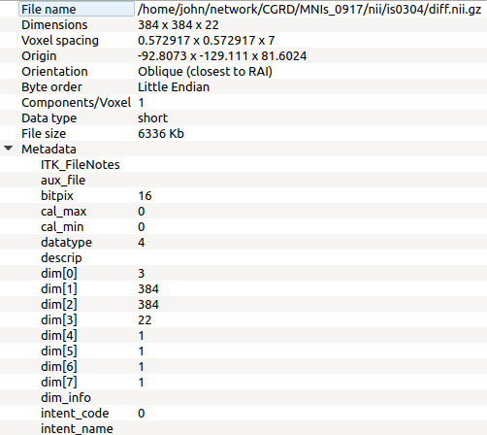

Slide 9
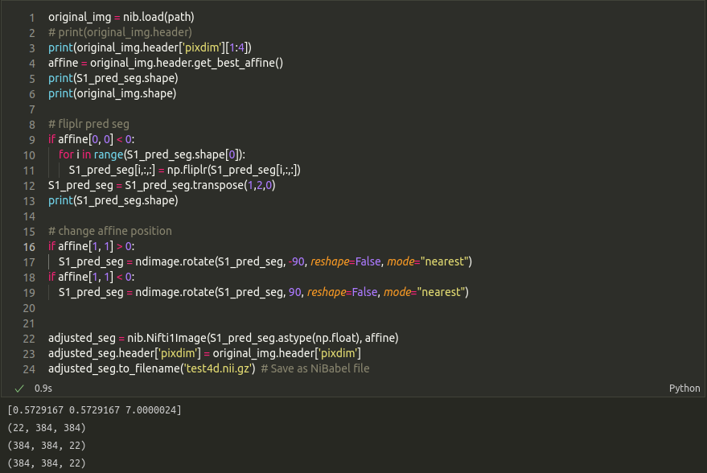

Slide 10
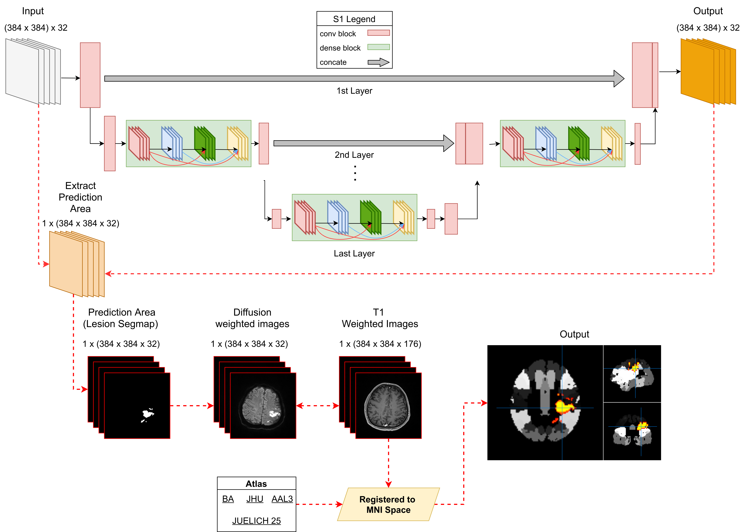

Slide 11
Problem
DWI和SegMap的pixbit不一致，部份讀取程式會出錯
刪除轉換的DWI P0 Dimension
BA, AAL3 圖譜對齊標記會往上多一層
S1 的model對於negtive sample的預測容易出現誤判

Slide 12
T1 Mprage
Patient | Image | Mprage
485 | 509 | 94

Slide 13
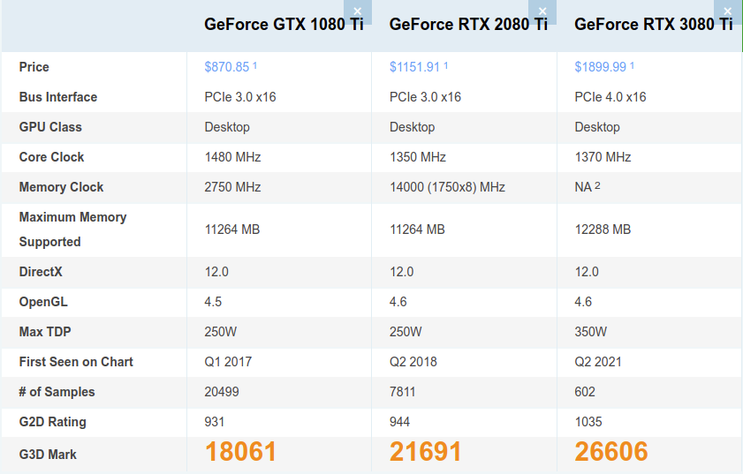

Slide 14
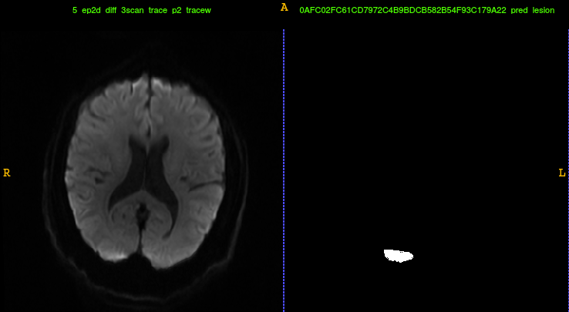
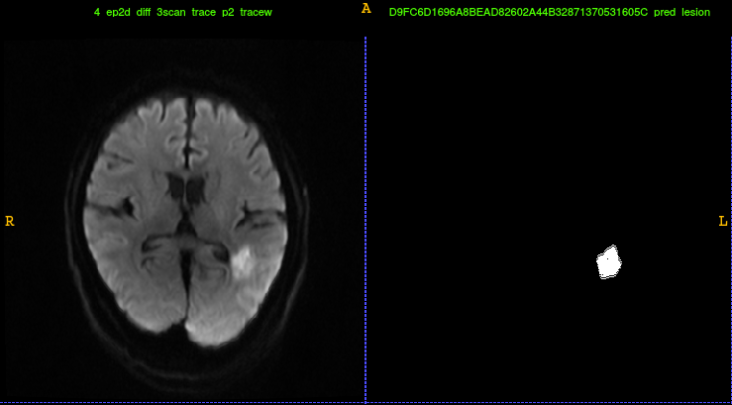
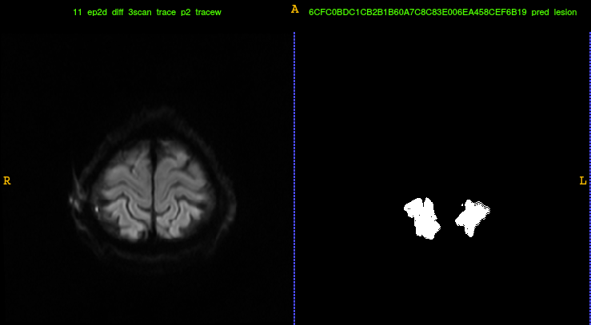
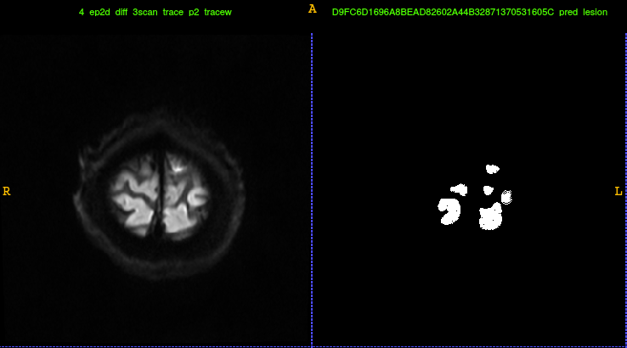

Slide 15
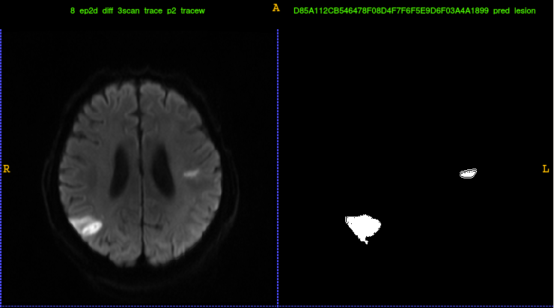
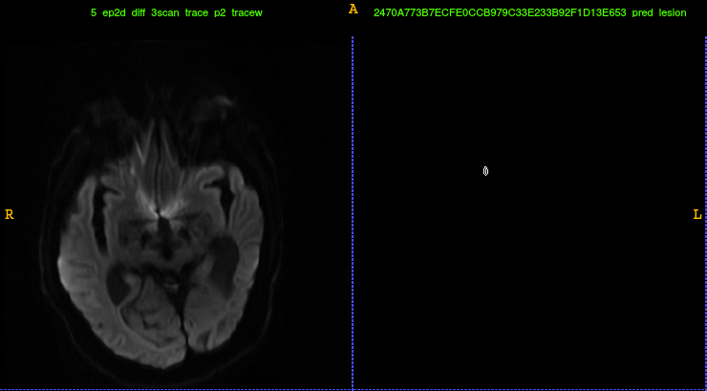
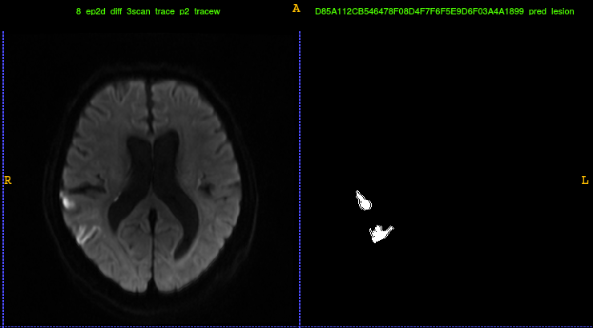
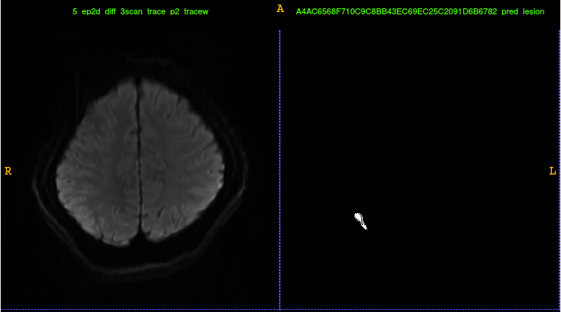

Slide 16
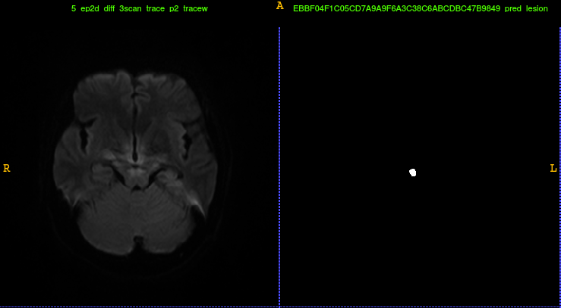

Slide 17
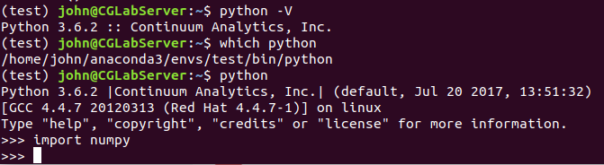
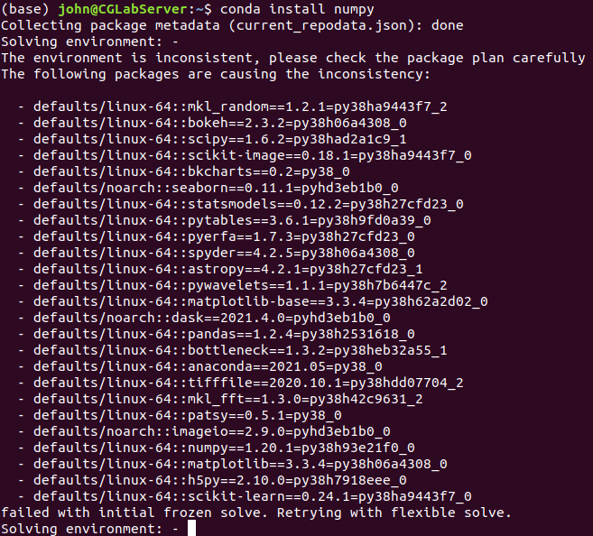
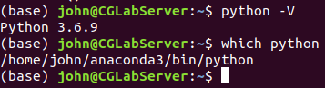
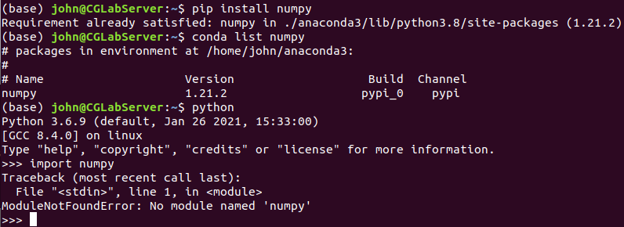
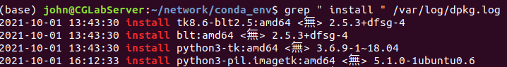

Slide 18
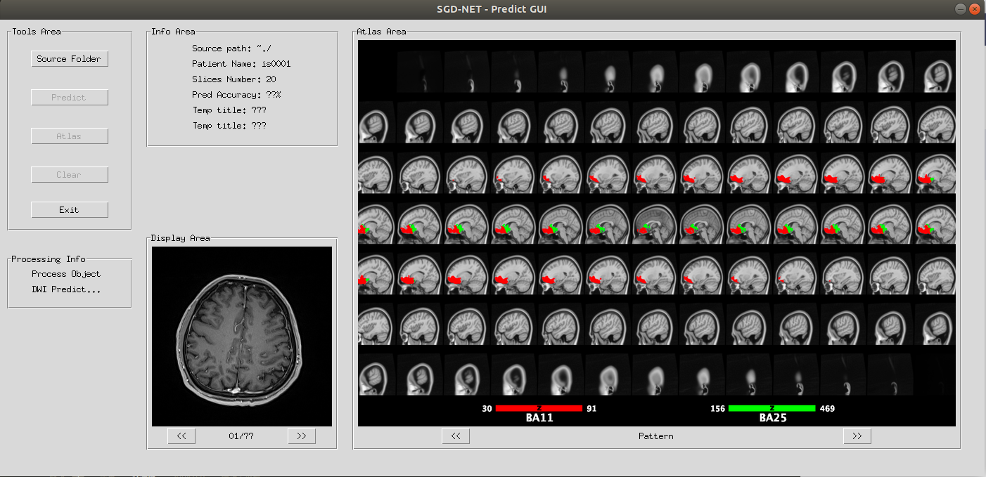

Slide 19
PreTrain - SGDNet
Negative Image - no0001~no0050
Lesion Image - Black Slice

Slide 20
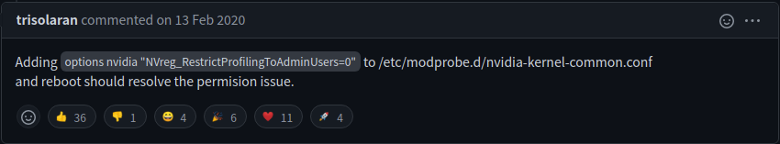
error CUPTI_ERROR_NOT_INITIALIZED

Slide 21
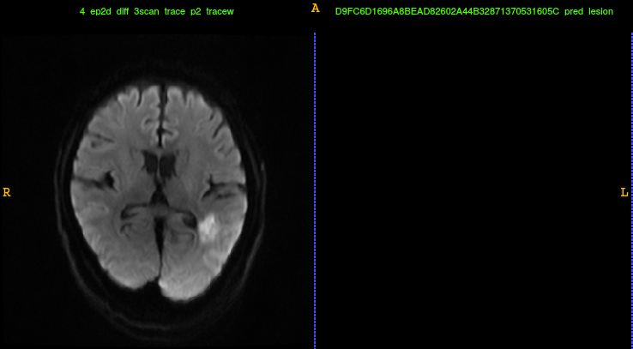
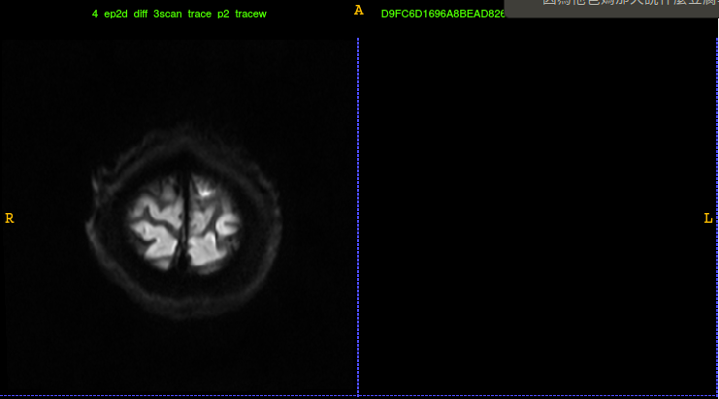

Slide 22
SGD-Net GUI
function | state
Dicom to nii | V
Predict dwi | V
Display dwi & Predict lesion | V
Nii to MNI Atlas | V
Switch Atlas Pattern | -
List Atlas info | V
Save Atlas Image | -
Optimized | -
SSH Connected | V

Slide 23
model adjust
loss funciton : remove smooth value
negative data: 50(40,10) -> 20(15,5)
30 x (384 x384 x 22) -> 30 x 22x (384 x384)

Slide 24
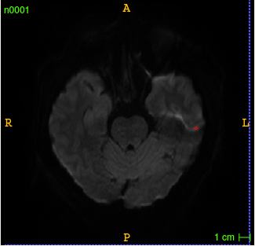
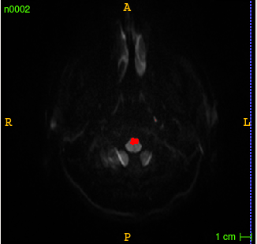
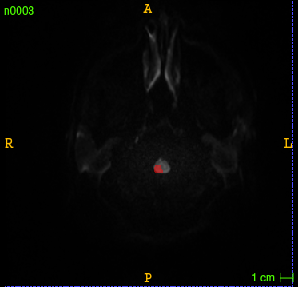
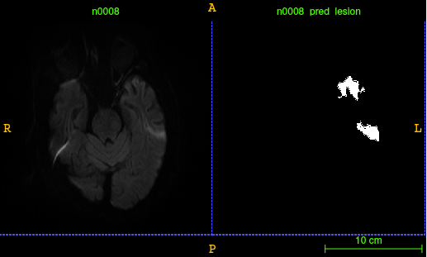
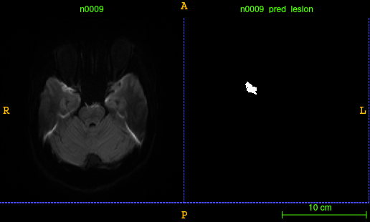
focal tversky loss initialization adjust - False Negative

Slide 25
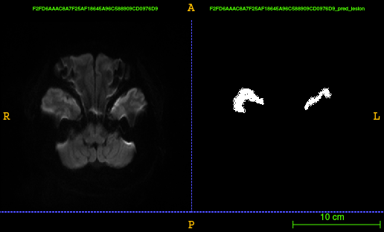
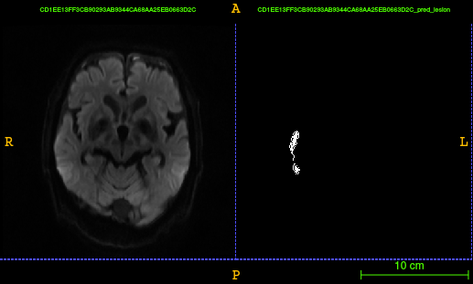
focal tversky loss initialization adjust - False Negative

Slide 26


Slide 27



磐石平台 (大學)

Slide 28


Z-Score Normalization for single slice

Slide 29



Fuzzy C-means (FCM)-based tissue-based mean normalization

Slide 30



fcm - lr 0.03 - focal gamma 2.0 - threshold 0.5
Notes:
整體negative在threshold0.5情況下都完全去除 但是positive被嚴重忽略

Slide 31


Data augmentation techniques for medical image?
https://www.researchgate.net/post/Data-augmentation-techniques-for-medical-image

Slide 32


Pytorch S1 SGD - memory used
keras model
pytorch model
 | memory used | disk used | single epoch sec | max batch size | GPU memory
Keras | 5.0GB ~ 10GB | 9GB | 294 sec | 8 | 10GB
Pytorch | 2.0GB ~ 6GB | 20MB | 240 sec | 24 or More | 7GB

Slide 33





Slide 34


HarDNet-MSEG - Data Augmentation and Data Input

Slide 35


Gradient Clipping
引入Gradient Clipping解決梯度爆炸問題
將Gradient 約束在一個範圍內，這樣不會使得Gradient 過大

Slide 36

Adam and AdamW decay weight are different

Slide 37

Multi Scale Training

Slide 38

Affine transform

Slide 39

transform in model class

Slide 40

transform affine for Pytorch.io

Slide 41
Pytorch ResNet18 - Problem（ap）
metric reply 有一些問題
Sensitivty 過低

Slide 42

Multi layer conate

Slide 43
To DO
短期預後：
住院內短期惡化
*24小時至7天內惡化
長期預後：
一年內再次中風
一年內死亡

Slide 44
To DO
SGD-Net add 1.5T image.
FSL :gray matter, white matter (T1)
ATLAS: Anatomical Tracings of Lesions After Stroke (T1)
CGRD 資料串連(outcome)
一年內再次中風
一年內死亡
CGRD 短期資料(text mining)

Slide 45


S2 3DResNet Valiataoin&Train

Slide 46
List
Pytorch S1 2D Unet V
Pytorch S2 3D Resnet NL V
Pytorch S2 3D Resnet AP V
Pytorch SGD-Net Evaluate X
Add 1.5T image X

Slide 47

S2 3DResNet Valiataoin&Train (3.0T + 1.5T)

Slide 48
Predict error
Raw Data check V
Normalized check X
dwi header bipix failed
Model weight loader check V
Data label check V
Predict score relpy check V
Metric score code check V
Dataloader check X
第二次(S2) loader的時候data出問題

Slide 49

dwi header normalized failed - (bitpix)

Slide 50


Slide 51


Slide 52
S1 Problem
keras Learning rate decay not cosine weight
only epoch learning rate decay
fixed Tversky Focal loss gamma -> 0.75 to 2.00

Slide 53


Cosine weight decay - max reply step
Pytorch version Keras version

Slide 54
Multiclass Program
S1 MultiClass Unet V
S1 MultiClass Loss (FocalTverskyLoss) V
S1 MultiClass Metric X
S2 MultiClass 3D Network V
S2 MultiClass Loss V
S2 MultiClass Metric V

Slide 55

MultiModel Architecture
Early Fusion
Deep Fusion
Late Fusion(Ensemble)

Slide 56


Slide 57



Slide 58
AI中心 User Login
VPN connect Host
↓
Putty SSH Login
↓
Terminal Login
↓
Dark-Image Load(可省略)
↓
Linux OS
儲存空間與OS是分開的
可提供免費諮詢服務
已提供基礎的ML和DL環境
可使用Telnet遠端儲存資料（需掛VPN）

Slide 59


GraphVQA - Install API error
Traceback (most recent call last):
File "<stdin>", line 1, in <module>
ImportError: cannot import name '_new_empty_tensor' from 'torchvision.ops' (/home/data/anaconda3/envs/XXX_mdetr/lib/python3.8/site-packages/torchvision/ops/__init__.py)
Traceback (most recent call last): File "pipeline_model_gat.py", line 850, in <module> load_vocab_flag=True File "/home/data/repo/GraphVQA/gqa_dataset_entry.py", line 468, in __init__ self.load_qa_vocab() File "/home/data/repo/GraphVQA/gqa_dataset_entry.py", line 578, in load_qa_vocab text_reloaded = pickle.load(f) ModuleNotFoundError: No module named 'torchtext.data.field'

Slide 60
GraphVQA - Dataset
raw data type - .json
position label type - .json

Slide 61
EMR Process - ElasticNet(L1+L2)
The demographic features
gender, race, smoking habits, age...
one-hot.
Vitals features
systolic and diastolic blood pressure, height, weight, BMI, temperature,respiration rate, spO2, HR..
Taking the derivative of the vital values along the temporal axis.
Inpatient and outpatient medication feature
641 unique classes of drugs
The frequency within the 12 month window and a binary label.
ICD-9 codes
Excluded all ICD-9 codes with less than 1% occurrences in the training dataset and collapsed into top diagnosis categories.
the same encounter number as the patient’s CT exam, or within a 24 hour window prior to their CT examination were dropped to avoid data leakage.
Used a binary(presence/absence)

Slide 62
CT Process - PENet
CT image
224 x 224 x N (N = Used sliding window, init=24)

Slide 63

Model block componse

Slide 64


Slide 65





Slide 66


VPN - putty ERROR

Slide 67
MultiGPU - Torch DistributedDataParallel(DDP)
收斂速度沒有變快
GPU之間溝通速度有點慢 (雖然還是有比單張的快一點)
NasServer與model之間傳遞資料的延遲過高
根據log顯示，效能上沒有太多變化
當前的資料量用DDP並沒有比較好的效能表現

Slide 68





Fusion Model

Slide 69

Transfer Learning

Slide 70




Transfer Learning - Freeze Layer
Original model - FC1(Freeze)
Freeze model - FC1(Freeze)
Original model - FC2(NoFreeze)
Freeze model - FC2(NoFreeze)

Slide 71



Transfer Learning
Feature Extracter
Pretrain Model
Freeze Model

Slide 72



Fusion model

Slide 73
TL - 1000Sample (Feature Extracter)
Dataset | Sepsis 0 | Sepsis 1 | Train ACC | Train AUC | Test ACC | Test AUC
Original | 514 patient | 41 patient | 0.9336 | 0.9062 | 0.9280 | 0.8914
Train 12.13(value Nan = median value)
LOC 1 | 72 patient | 7 patient | 0.9661 | 0.9777 | 0.8500 | 0.1666
LOC 2 | 105 patient | 20 patient | 0.9921 | 0.9999 | 0.8823 | 0.7214
LOC 3 | 642 patient | 144 patient | 0.9671 | 0.9940 | 0.8984 | 0.9182
Train 12.14 (Sofa value Nan = 0)
LOC 1 | 72 patient | 7 patient | 0.9661 | 0.9703 | 0.8500 | 0.3055
LOC 2 | 105 patient | 20 patient | 0.9765 | 0.9988 | 0.8823 | 0.7517
LOC 3 | 642 patient | 144 patient | 0.9671 | 0.9909 | 0.8883 | 0.9135

Slide 74
TL - 1000Sample (Pretrain model)
Dataset | Sepsis 0 | Sepsis 1 | Train ACC | Train AUC | Test ACC | Test AUC
Original | 514 patient | 41 patient | 0.9336 | 0.9062 | 0.9280 | 0.8914
Train 12.13(value Nan = median value)
LOC 1 | 72 patient | 7 patient | 0.9152 | 0.9555 | 0.9000 | 0.6944
LOC 2 | 105 patient | 20 patient | 1.0000 | 1.0000 | 0.8529 | 0.6620
LOC 3 | 642 patient | 144 patient | 0.9671 | 0.9935 | 0.8832 | 0.9149
Train 12.14 (Sofa value Nan = 0)
LOC 1 | 72 patient | 7 patient | 0.9152 | 0.9851 | 0.9000 | 0.6666
LOC 2 | 105 patient | 20 patient | 1.0000 | 1.0000 | 0.8529 | 0.8344
LOC 3 | 642 patient | 144 patient | 0.9595 | 0.9906 | 0.8984 | 0.9508

Slide 75
TL - 1000Sample (Freeze model)
Dataset | Sepsis 0 | Sepsis 1 | Train ACC | Train AUC | Test ACC | Test AUC
Original | 514 patient | 41 patient | 0.9336 | 0.9062 | 0.9280 | 0.8914
Train 12.13(value Nan = median value)
LOC 1 | 72 patient | 7 patient | 0.9661 | 0.9666 | 0.9000 | 0.6944
LOC 2 | 105 patient | 20 patient | 0.9552 | 0.9675 | 0.8235 | 0.8965
LOC 3 | 642 patient | 144 patient | 0.9187 | 0.9398 | 0.8984 | 0.9372
Train 12.14 (Sofa value Nan = 0)
LOC 1 | 72 patient | 7 patient | 0.9322 | 0.8740 | 0.9000 | 0.6111
LOC 2 | 105 patient | 20 patient | 0.9609 | 0.9775 | 0.8529 | 0.8344
LOC 3 | 642 patient | 144 patient | 0.9173 | 0.9389 | 0.8883 | 0.9177

Slide 76
FL - 1000Sample (Federated Learning)
Dataset | Sepsis 0 | Sepsis 1 | Train ACC | Train AUC | Test ACC | Test AUC
Transfer Learning
Original | 514 patient | 41 patient | 0.9336 | 0.9062 | 0.9280 | 0.8914
LOC 1 | 72 patient | 7 patient | 0.9661 | 0.9666 | 0.9000 | 0.6944
LOC 2 | 105 patient | 20 patient | 0.9552 | 0.9675 | 0.8235 | 0.8965
LOC 3 | 642 patient | 144 patient | 0.9187 | 0.9398 | 0.8984 | 0.9372
Federated Learning
Original | 514 patient | 41 patient | - | - | 0.9009 | 0.9500
LOC 1 | 72 patient | 7 patient | - | - | 0.9000 | 0.9166
LOC 2 | 105 patient | 20 patient | - | - | 0.8529 | 0.8241
LOC 3 | 642 patient | 144 patient | - | - | 0.8172 | 0.9256

Slide 77


Notes:
Federated vs transfer ?
baseline的結果 將原本555的wiehgts拿去驗證loc1,2,3
federated learning 加入freeze model type
average weight

Slide 78

Keras - S1 Result
backbone | train dice | test dice
DenseNet121 | 0.8702 | 0.7777
ResNet50 | 0.8658 | 0.8025

Slide 79
TL - Feature Extracter
Feature Extracter
Dataset | Sepsis 0 | Sepsis 1 | Train ACC | Train AUC | Test ACC | Test AUC
Original | 514 patient | 41 patient | 0.9336 | 0.9062 | 0.9280 | 0.8914
Train 12.14 Sample 1000
Taipei | 72 patient | 7 patient | 0.9661 | 0.9703 | 0.8500 | 0.3055
Keelung | 105 patient | 20 patient | 0.9765 | 0.9988 | 0.8823 | 0.7517
Linkou | 642 patient | 144 patient | 0.9671 | 0.9909 | 0.8883 | 0.9135
Sample 16300
Taipei | 1212 patient | 45 patient | 0.9675 | 0.8533 | 0.9649 | 0.7611
Keelung | 1854 patient | 404 patient | 0.8967 | 0.8962 | 0.8247 | 0.7056
Linkou | 10303 patient | 2491 patient | 0.8434 | 0.8295 | 0.8343 | 0.8127

Slide 80
TL - Pretrain model
Pretrain model
Dataset | Sepsis 0 | Sepsis 1 | Train ACC | Train AUC | Test ACC | Test AUC
Original | 514 patient | 41 patient | 0.9336 | 0.9062 | 0.9280 | 0.8914
Train 12.14 Sample 1000
Taipei | 72 patient | 7 patient | 0.9152 | 0.9851 | 0.9000 | 0.6666
Keelung | 105 patient | 20 patient | 1.0000 | 1.0000 | 0.8529 | 0.8344
Linkou | 642 patient | 144 patient | 0.9595 | 0.9906 | 0.8984 | 0.9508
Sample 16300
Taipei | 1212 patient | 45 patient | 0.9649 | 0.8640 | 0.9649 | 0.7544
Keelung | 1854 patient | 404 patient | 0.8863 | 0.8887 | 0.8212 | 0.7108
Linkou | 10303 patient | 2491 patient | 0.8398 | 0.8316 | 0.8308 | 0.8118
Notes:
baseline

Slide 81
TL - Freeze model
Freeze model
Dataset | Sepsis 0 | Sepsis 1 | Train ACC | Train AUC | Test ACC | Test AUC
Original | 514 patient | 41 patient | 0.9336 | 0.9062 | 0.9280 | 0.8914
Train 12.14 Sample 1000
Taipei | 72 patient | 7 patient | 0.9322 | 0.8740 | 0.9000 | 0.6111
Keelung | 105 patient | 20 patient | 0.9609 | 0.9775 | 0.8529 | 0.8344
Linkou | 642 patient | 144 patient | 0.9173 | 0.9389 | 0.8883 | 0.9177
Sample 16300
Taipei | 1212 patient | 45 patient | 0.9656 | 0.8385 | 0.9649 | 0.8066
Keelung | 1854 patient | 404 patient | 0.8452 | 0.7702 | 0.8230 | 0.7198
Linkou | 10303 patient | 2491 patient | 0.8226 | 0.7480 | 0.8199 | 0.7575

Slide 82
FL - 16300 Sample (Federated Learning)
Dataset | Sepsis 0 | Sepsis 1 | Train ACC | Train AUC | Test ACC | Test AUC
Federated Learning - 3 LOC (Feature Extracte)
Original | 514 patient | 41 patient | - | - | 0.9999 | 0.9999
Taipei | 1212 patient | 45 patient | - | - | 0.9394 | 0.7422
Keelung | 1854 patient | 404 patient | - | - | 0.8424 | 0.7770
Linkou | 10303 patient | 2491 patient | - | - | 0.8318 | 0.8108
Federated Learning - 2 LOC (Feature Extracte)
Original | 514 patient | 41 patient | - | - | 0.9999 | 0.9999
Taipei | - | - | - | - | - | -
Keelung | 1854 patient | 404 patient | - | - | 0.8389 | 0.7842
Linkou | 10303 patient | 2491 patient | - | - | 0.8289 | 0.8145

Slide 83
BaseLine - 16300 Sample
Dataset | Survival | Mortality | Train ACC | Train AUC | Test ACC | Test AUC
BaseLine - Loading 555 patient best model weight
Original | 514 patient | 41 patient | 0.9336 | 0.9062 | 0.9280 | 0.8914
Taipei | 1212 patient | 45 patient | - | - | 0.9649 | 0.7518
Keelung | 1854 patient | 404 patient | - | - | 0.8212 | 0.5769
Linkou | 10303 patient | 2491 patient | - | - | 0.8052 | 0.5606
Notes:
*AUC部份應該以Train Result當作儲存wieght的Listener <重做>

Slide 84
FL - 16300 Sample (Federated Learning)
Dataset | Survival | Mortality | Train ACC | Train AUC | Test ACC | Test AUC
Federated Learning - 3 LOC (Feature Extracte)
Server | 514 patient | 41 patient | 0.9976 | 0.9999 | 0.9496 | 0.9364
Taipei | 1212 patient | 45 patient | 0.9639 | 0.8221 | 0.9649 | 0.7026
Keelung | 1854 patient | 404 patient | 0.8600 | 0.8337 | 0.8442 | 0.7881
Linkou | 10303 patient | 2491 patient | 0.8053 | 0.8209 | 0.8052 | 0.8088
Federated Learning - 3 LOC (Freeze model)
Server | 514 patient | 41 patient | 0.9831 | 0.9999 | 0.9424 | 0.7717
Taipei | 1212 patient | 45 patient | 0.9639 | 0.7852 | 0.9649 | 0.7883
Keelung | 1854 patient | 404 patient | 0.8210 | 0.7420 | 0.8212 | 0.7441
Linkou | 10303 patient | 2491 patient | 0.8185 | 0.7482 | 0.8121 | 0.7539

Slide 85


Average weight (Tensorflow TFF)
Averaging the weights by the inverse variance
Balance Dataset: IID % No-IID
Notes:
變異數的倒數weight
樣本數加權： 樣本數weight 大；

Slide 86


Federated Learning - Server Side Weight
Feature Extracted
Freeze Model
Notes:
To Do 論文回應 https://arxiv.org/pdf/2107.09627.pdf

Slide 87

Sample Weight

Slide 88
Federated Learning - Sample Weight
Dataset | Survival | Mortality | Train ACC | Train AUC | Test ACC | Test AUC
Federated Learning - 3 LOC (Feature Extracte) [Average Weight]
Server | 514 patient | 41 patient | 0.9976 | 0.9999 | 0.9496 | 0.9364
Taipei | 1212 patient | 45 patient | 0.9639 | 0.8221 | 0.9649 | 0.7026
Keelung | 1854 patient | 404 patient | 0.8600 | 0.8337 | 0.8442 | 0.7881
Linkou | 10303 patient | 2491 patient | 0.8053 | 0.8209 | 0.8052 | 0.8088
Federated Learning - 3 LOC (Feature Extracte) [SampleWeight]
Server | 514 patient | 41 patient | 0.9254 | 0.9274 | 0.9280 | 0.8883
Taipei | 1212 patient | 45 patient | 0.9639 | 0.8073 | 0.9649 | 0.7830
Keelung | 1854 patient | 404 patient | 0.8210 | 0.7931 | 0.8212 | 0.7743
Linkou | 10303 patient | 2491 patient | 0.8053 | 0.8206 | 0.8052 | 0.8150

Slide 89
Fusion Model - mRS
model Type | Valid Accuracy | Valid Sensitivity | Valid Specificity
Fusion Model(Seg) | 0.8800 | 0.8076 | 0.9333
Fusion Model(Non-Seg) | 0.8800 | 0.8461 | 0.9000
DWI Image | 0.6800 | 0.3461 | 0.9666
Nihss Score | 0.8600 | 0.8461 | 0.8666
Notes:
目前Image model能提供的效能推力非常不夠或是可以說接近沒有
需要找到比較符合這個case的fusion方法
單獨linear model就很接近fusion model
1.Non-seg model
2.A/P class + N/L class
3.3D CNN
4.NLP 血管
Data Augmentation, Threshold, AUC

Slide 90
Fusion Model
Fusion Model - 3D ResNet + 1 Layer Linear
Image Model - 3D ResNet
Nihss Model - 2 Layer Linear

Slide 91



Fusion Model - Accuracy Result

Slide 92
To Do
NIHSS+MRI Image - Fusion model
CGRD trial
Done (Push on Github)
SGD-Net
SGD-Net Plus (70%)
Pytorch SGD-Net
Pytorch 1.5T+3.0T SGD-Net
Transfer Learning - Freeze Model, Feature Extracte, Pre-trained Model
Federated Learning - Sepsis Survival, Mortality(555 + 16300 patient)
Notes:
整合形計畫 Transfer Leaning , Federated Leaning

Slide 93
Fusion Model - mRS
model Type | Validation
 | Accuracy | Sensitivity | Specificity | AUC
Fusion Model(Seg) | 0.8800 | 0.8076 | 0.9333 | 0.9141
Fusion Model(Non-Seg) | 0.8800 | 0.8461 | 0.9000 | 0.9089
DWI Image(Seg) | 0.6800 | 0.3461 | 0.9666 | 0.7230
DWI Image(Non-Seg) | 0.6800 | 0.5384 | 0.8000 | 0.6628
Nihss Score | 0.8600 | 0.8461 | 0.8666 | 0.9153
Notes:
目前Image model能提供的效能推力非常不夠或是可以說接近沒有
需要找到比較符合這個case的fusion方法
單獨linear model就很接近fusion model
1.Non-seg model
2.A/P class + N/L class
3.3D CNN
4.NLP 血管
Data Augmentation, Threshold, AUC

Slide 94

Fusion Model - Classification

Slide 95





Fusion Model - mRS Plot

Slide 96

Multimodel Fusion Model - RNN

Slide 97

Python - IC

Slide 98
Fusion Model - mRS （IC)
model Type(DWI’nihss) | Validation
 | Accuracy | Sensitivity | Specificity | AUC (IC)
Fusion Model(Seg) | 0.8800 | 0.8076 | 0.9333 | 0.9141 [0.8343-0.9833]
Fusion Model(Non-Seg) | 0.8800 | 0.8461 | 0.9000 | 0.9089 [0.8307-0.9789]
DWI Image(Seg) | 0.6800 | 0.3461 | 0.9666 | 0.7230 [0.5882-0.8625]
DWI Image(Non-Seg) | 0.6800 | 0.5384 | 0.8000 | 0.6628 [0.5070-0.8089]
Nihss Score | 0.8600 | 0.8461 | 0.8666 | 0.9153 [0.8424-0.9795]
Notes:
目前Image model能提供的效能推力非常不夠或是可以說接近沒有
需要找到比較符合這個case的fusion方法
單獨linear model就很接近fusion model
1.Non-seg model
2.A/P class + N/L class
3.3D CNN
4.NLP 血管
Data Augmentation, Threshold, AUC

Slide 99




NIHSS Score

Slide 100

LSTM Many Feature to One

Slide 101

bug - jupyter version error

Slide 102

bug - tqdm version error

Slide 103
R & Python - IC
model Type | Validation
 | R AUC (IC) | Python AUC (IC)
DWI Image(Seg) | 0.7231 [0.5872-0.8589] | 0.7230 [0.5882-0.8625]

Slide 104





Out_Nihss - In_Nihss

Slide 105
Model adjust
learning rate - 0.01-0.003
loss function - focal loss & CrossEntropy
class weight - CrossEntropy weight
LR decay - cosineLR(SGD optimizer)

Slide 106


Regression Result- only NIHSS Score
Variable
A/P_01 | N/L_01 | age | gender
onset-to-image (有acute-發病日期) | onset-to-ward (病房日期-發病日期) | NIHSS: 1a | NIHSS: 1b
NIHSS: 1c | NIHSS: 2 | NiHSS: 3 | NIHSS: 4
NIHSS: 5a | NIHSS: 5b | NIHSS: 6a | NIHSS:6b
NIHSS:7 | NIHSS:8 | NIHSS:9 | NIHSS:10
NIHSS:11 | NIHSS total | - | -
Metric | VAlid Score
MAE | 1.2111
MSE | 6.5641
MAPE | 0.2946
Notes:
沒有做Normalized
Normalized會overfitting
best hyperparameter = Adam, lr 0.003, gradient clip 0.5

Slide 107




DWI+NIHSS (out-in) Result
Notes:
增加nihss score sample
BERT

Slide 108
DWI+NIHSS Regression Result

Slide 109




Bert Stroke
Create TF_dataset
create_pretraining_data.py
--input_file ../data/nu_note.txt
--output_file ../data/tfrecords/nu_note.tfrecord
--vocab_file=../models/biobert_pretrain_output_all_notes_150000/vocab.txt

Slide 110

Bert - GELU

Slide 111




dicom to nii type
is351~..
Total 1048 nii / patient
filter - 321 nii / patient
T1 is001~is350
To DO
Notes:
21AK20227X01

Slide 112




problem

Slide 113


crash

Slide 114


crash

Slide 115
dicom to nii type
Done
d2n - T1 is0001~is350
To Do
is0001~is350 - 人工排除重複檔案、重照影像。
做初步Image Fusion Model: DWI與T1 MRI
3D ResNet10、3D CNN
Notes:
21AK20227X01

Slide 116

MutiModel - T1&DWI (ResNet10)

Slide 117
dicom to nii type
Done
is0001-is0350 T1&DWI nii Dataset
T1 - resize (512, 512, 28)
DWI - resize (384, 384, 28)
Image Model Architecture
Image Model Dataloader
To Do
Data Augmentation
change affine space value: T1+DWI
Notes:
21AK20227X01

Slide 118




Bug - shape error

Slide 119

Transfrom crash - debug
Done
Fixed affine information
Trained Initialization Model
Valided Initialization Model
To do
Changed transform api: MONAI
Concate Multi Image Model and Text Model
Notes:
只要Data Augmentation有動到wight, height就會出現shape error

Slide 120



MONAI - DataLoader Transformer Build

Slide 121
List
Done
Changed dataloader&transform api: MONAI
To do
T1w process
Concate Multi Image Model and Text Model
Notes:
只要Data Augmentation有動到wight, height就會出現shape error
關於t1w的含水量， 關於腦容量sample問題

Slide 122

MONAI - Dataloader & Transform

Slide 123




T1w Process

Slide 124
Done
Used MONAI api to training model(mRS)
Review attention function
To do
Replace ResNet model to ResNext model
Add attention layer to training model

Slide 125
Fusion model (Non-augmenation)
 | Torch-io | MONAI
batch-size | 3 | 3
GPU memoy | 9.6 GB | 9.8 GB
image size | D(512,512,28) T(512,512,28) | D(384,384,28) T(512,512,28)
one epoch | 120 ([train]75+[valid]45) sec | 55 ([train]44+[valid]11) sec

Slide 126




DWI+T1w - Results
Notes:
Optimizer: Adam
Learning rate: 0.003
Augmentation: random 15.degree
Epochs: 150
Model: 3D ResNet10

Slide 127
Fusion architecture
不同的特徵重要性在經過數層之後很難trace
通常會用attention來自動學習哪邊重要
在concat之前做attention
萬一不同類型特徵有明顯重要程度不同，就會被消彌
在concat之後做attention
可能會被明顯的特徵dominant，造成其他特徵幫助不大

Slide 128



3D ResNext

Slide 129
Done
Organize conda environment
Conv&Linear mat normalized
Review medical image & classification attention
To do
Notes:
stroke mimic
mri image vs nihss score

Slide 130



Normalized
Batch Normalized
Layer Normalized
Weight Normalized

Slide 131

Attention architecture
Attention Layer (API Function)
Self attention、SE attention
Mix-MLP attention model
MLP-Mixer、g&sMLP
Backbone attention layer
ResNet、ResNeXt

Slide 132

Residual Attention Network for Image Classification

Slide 133


Residual Attention Network for Image Classification

Slide 134


CBAM: Convolutional Block Attention Module

Slide 135


A 3D densely connected convolution neural network with connection-wise attention mechanism for Alzheimer's disease classification

Slide 136


3.0T - is0351~is0675

Slide 137



CAM-CNN
Notes:
deep learning rewiew

Slide 138


CNN vs fcn(fully connected network)

Slide 139

Nas Net architecture
Search Space
Search Strategy
Performance Estimation Starategy
Notes:
Search Space
中文又稱作為搜索空間，也就是我們在選擇 neural architecture 時，我們所可以調整的所有選擇。舉例來說，kerne size, channel size, convolution type 以及 layer number 等等。
Search Strategy
在給定的 search space 當中，我們要透過什麼方式來搜索出最好的 neural architecture。舉例來說，在搜索 hyperparameter 時最為大家熟悉的 grid search 以及 random search，或是 evolution algorithm (基因演算法) 等等。
Performance Estimation Strategy
當我們從 search space 當中挑選出了一個 neural architecture，我們如何評估這個 neural architecture 是好還是壞的方式。舉例來說，我們可以實際的訓練每個 neural architecture 來獲得實際的 top-1 accuracy，我們也可以訓練少量的 neural architecture，並且將實際訓練好的數據，用來訓練一個額外的 accuracy predictor。

Slide 140


Reinforcement Learning & Progressive NAS

Slide 141

One-shot NAS

Slide 142

Differentiable NAS

Slide 143

Multi-path NAS & Single-path NAS

Slide 144
Medical deep learning - Historical
2015-2016 - TL (Transfer Learning)
Natural Image model apply to medical images
Federated Learning for medical data(Image/ non-IID)
2017-2018
Generate liver image (Generative Adversarial Netwrok)
Estimating full-dosage PET images from low-dosage PET
3D CNN Net (2018)
Lung segmentation (U-Net)、Microscopic cell segmentation
Simi-supervised (weakly supervised) learning for MRI (2017)
2019 - 2020 - Fusion & Attention & Transfomer & NAS
Fusion model (de-noise)
Leveraging the anatomy knowledge embedded in CT to decompose a chest X-ray

Slide 145

LSTM COVID 19
A combined deep CNN-LSTM network for the detection of novel coronavirus (COVID-19) using X-ray images ◎

Slide 146

LSTM COVID 19
Predicting COVID-19 disease progression and patient outcomes based on temporal deep learning ◎

Slide 147



COVID-19 - Sequence

Slide 148


Patient Subtyping via Time-Aware LSTM Networks (T-LSTM) ◎

Slide 149


T-LSTM
Notes:
基於
bi-lstm的Timeline模型（加入了時間敏感度）
TDNN（考慮了時間延遲）

Slide 150


Genome-wide identification and prediction of SARS-CoV-2 mutations show an abundance of variants: Integrated study of bioinformatics and deep neural learning ◎
Notes:
針對基因序列的組合去做預測 例如未來哪幾個組合會出現 哪幾個可能不會在出現
keyword: genomic, covid-19, LSTM, SARS-CoV-2, sequence, predict

Slide 151


Time series prediction of COVID-19 by mutation rate analysis using recurrent neural network-based LSTM model ◎

Slide 152


(Perturbation-Based): Occlusion Sensitivity, Meaningful Perturbation

Slide 153
Sepuence to Image type
DeepCOVID-19: A model for identification of COVID-19 virus sequences with genomic signal processing and deep learning ◎

Slide 154
LSTM_CNN
video
shape = (16, 3 ,241,241) (16 frames) (.avi)
classes = 51
MRI
shape = (28,1,348,348) (28 frames) (.nii)
classes = 2

Slide 155







MRI to video slice
Notes:
384,384 會導致當前的記憶不足
影像轉換階段會失真 -> 在dataloader裡直接轉換

Slide 156


Video Classification Model

Slide 157
Predict mutation
SARS‐CoV‐2 variant with mutations in N gene affecting detection by widely used PCR primers ◎
PCR method
Using artificial intelligence techniques for COVID-19 genome analysis ◎
Learning using SPM and sequence prediction techniques
Explainable deep neural networks for novel viral genome prediction ◎
CNN+LSTM
Analyzing hCov Genome Sequences: Predicting Virulence and Mutation ◎
https://github.com/pythonLoader/Analyzing-hCov-Genome-Sequence
ML+DL

Slide 158


LSTM-CNN

Slide 159



COVID19 - feature weight heatmap
Alpha (B.1.1.7-like)
Beta (B.1.351-like)
Beta (B.1.351-like)

Slide 160

COVID19 - feature weight heatmap (mix)
Delta (B.1.617.2-like)
Delta (B.1.617.2-like)
Gamma (P.1-like)

Slide 161



COVID19 - feature weight heatmap
Delta (B.1.617.2-like)
Delta (B.1.617.2-like)
Gamma (P.1-like)

Slide 162

COVID19 - feature weight heatmap (mix)
Alpha (B.1.1.7-like)
Beta (B.1.351-like)
Beta (B.1.351-like)

Slide 163


COVID19 - feature weight heatmap (mix)

Slide 164


FCM Normalized
Z-score Normalized

Slide 165

2019-2020 ImageNet - Predict Eorror rate

Slide 166


AlexNet (2012)
Pooling architecture
avgpooling -> maxpooling
(conv 3x3, stride 2x2)
input szie
224x244
Activation Function
sigmoid -> Relu
Rebuild lenet model
Add dropout, data augmentaion

Slide 167

VGG (2014)
Change conv kernel size
reduce parameter
all conv kernel to (3x3)
Reduce pooling size
3 x 3 -> 2 x 2 (Get more information)
Stack more conv layer
build deep model

Slide 168

VGG (2014)
Parameter Number
5 conv
(5 x 5 x C ^2)
2 x ( 3 x 3 x C^2)
7 conv
(7 x 7 x C^2)
3 x (3 x 3 x C^2)

Slide 169

raw data vs Z-score normalized data

Slide 170


Slide 171


Slide 172


Slide 173

Transformer Model

Slide 174

Process Sequences

Slide 175

Image captioning

Slide 176

Image captioning

Slide 177

Image Captioning with Attention

Slide 178

Image Captioning with Attention

Slide 179

Feature map (Heatmap)

Slide 180

Image Captioning with Attention

Slide 181


VQA - Vision Question Answering

Slide 182

Non-Attention and Attention

Slide 183

LSTM - ◎

Slide 184

SImilar Residualblock feedback

Slide 185

Neural Search for RNN architecture

